Slide 1
Physical activity, disability and social participation
Ph.d. project
Aktiv Fritid for Alle, Reykjavik 2013

Slide 2
Theme of the project
The theme of the project is the relation between participation in physical activity and other occurrences of everyday life of people with physical disabilities.

Slide 3
Participation
Definition:
Human action taking place under certain conditions, together with others in a social practise, in relation to a common cause.
(Critical Phychology)
Subjective as well as objective experience
Relation between the individual and society

Slide 4
What does the study tell us?
The athletes are active in many other contexts of society than only physical activity
They take experience from one context to another – also regarded through their life span
Participation in one context encourage participation in other contexts
The context of physical activity provides options to develop abilities which can be transformed into other contexts

Slide 5
Persons showing themselves as active people open doors while they become visible for others as a ressource in the community.
Participation depends on the readiness of the social community to make an effort, so that the person can make use of his/her abilities in the actual context from his/her actual position in relation to the common cause.
In physical activity he person may ’forget the body’, thus directing awareness towards the surrounding world.

Slide 6
Research Questions
How is the relation between participation in physical activity and everyday life of people with disabilities?
How do people with a physical disability experience the significance / meaning of participating in physical activity in relation to their everyday life?

Slide 7
Background: Disability and participation
People with disabilities participate to a lesser extend in society than other people
Social network limited
Feeling devaluated as human beings
Internalise negative attitudes from society
Barriers in society hinder participation in social communities
Unimployed more often than not-disabled
Few are members of leisure time activity clubs

Slide 8
Review of the literature
No studies are found that directly investigate the experienced impact of participation in physical activity to the everyday life of people with physical disabilities.
Most studies use interviews only, but this method seems not sufficient to elucidate the question
We must also look into the practices of everyday life and do observations.
’Participation in physical activity and everyday life of people with physical disabilities: A review of the literature.’
Scandinavian Journal of Disability Research 2013.

Slide 9
Statistic correlation
Telephone interview with 922 persons with various types of disabilities: Legs, arms, hands, vision, behaviour, intellect
Questions about participation in physical activity on regular basis away from home.

Slide 10
Participation in PA
57, 3 % are physically active out of home one or more times a week.
27,7 % in ordinary sports club
28 % join a fitness centre
15,7 % participate in a municipality gym
4,2 % are members of at disability sports club, and
70,6 % state that they practise self organised physical activities.
42,7 % are not physically active

Slide 11
Particiaption in other social contexts
Significant correlation between participation in physical activities on regular basis and
employment,
educational status,
volunteerism,
leisure time schooling
membership in a disability organization.
Kissow, A. & Singhammer,J. (2012).Participation in physical activity and everyday life of people with disabilities. European Journal of Adapted Physical Activity, 5(2). 65-81

Slide 12
Qualitative study - design
Qualitative design to understand how things are connected i social praxis.
Phenomenological hermeneutics as scientific framework
Method created for the actual purpose: Searching to understand and find meaning, create ‘thick data’, sensitive to nuances and keeping close to the lived experience of the informants.

Slide 13
Informants
7 Persons with physical disabilities, age 25-53
All of them regularly participants in physical activities: Golf, sailing, swimming, horse-back riding, wheel-chair rugby, handbiking, wheel-chair hockey, scouting
Various motives for and levels of participation

Slide 14
Method
Narrative interviews: ’Please, tell me about your life with physical activities’.
Observations of selected situations of the persons’ everyday life – including participation in physical activities. Scenic descriptions: As I see it.
Schedule of a typical week for the person
Photos of everyday occurences as a basis for further dialogue about the persons life world

Slide 15
Analysis
Searching for signs in data that may lead to an understanding of the meaning of participating in physical activity in relation to everyday life
Hermeneutic text analysis
Across narratives and observations
Theoretical reflection

Slide 16
Theory
Theories are used to reflect over and unfold empiry
Critical psychology (Holzkamp, Dreier)
Body-phenomenologi (Merleau-Ponty, Leder)
Learning as social practise (Lave & Wenger)
Stigma (Goffman) og liminality (Murphy, Turner)
The political body (Foucault)

Slide 17
Themes
The body participating
Being visible
Social appreciation and respect
Assisting others to participate
Being active in society
Physical abilities making participation possible

Slide 18
The body participating
Constraints in the options of body-actions in relation to the external environment has less significance:
As other persons in the social community give adequate support
As adaptation of the context provides options for the body as it is.
As tools are provides that may function as an ‘extension’ of the body in activity

Slide 19
In that case the person seems to forget the body (Leder 1990) and experience the body as reaching out towards the environment.
Thus the options of the person to participate fully in the actual social practise are enhanced.
And he is able to offer his ressources to the community and develop his participation

Slide 20
Example: Scenic description
Brian is alone in the boat. It’s wonderful, he says, smiling. He has a tailwind and the speed is fairly good. He is sailing in zigzag showing that he is in control of winds and sails. Being in the boat his has no need for personal assistance. I’m heading for the fiord, he states. I have a long way to go. Don’t go too far out the coach says. Why not? That’s why I’m here, Brian claims boldly and sets the sail against the wind.

Slide 21
Narrative
I learned sailing at a folk high school, when I was in my twenties. It was wonderful to be able to be in a sailing boat alone and be able to steer it myself. The instructor said: ’You’re son of a skipper, you have to learn sailing’. Then he pushed the boat and off I went! I had no other choice than to feel my way pulling the ropes. But after a while I actually figured out how to sail a mini 12er. There was a motor boat following me, looking after me a bit. I have been sailing since that time.

Slide 22
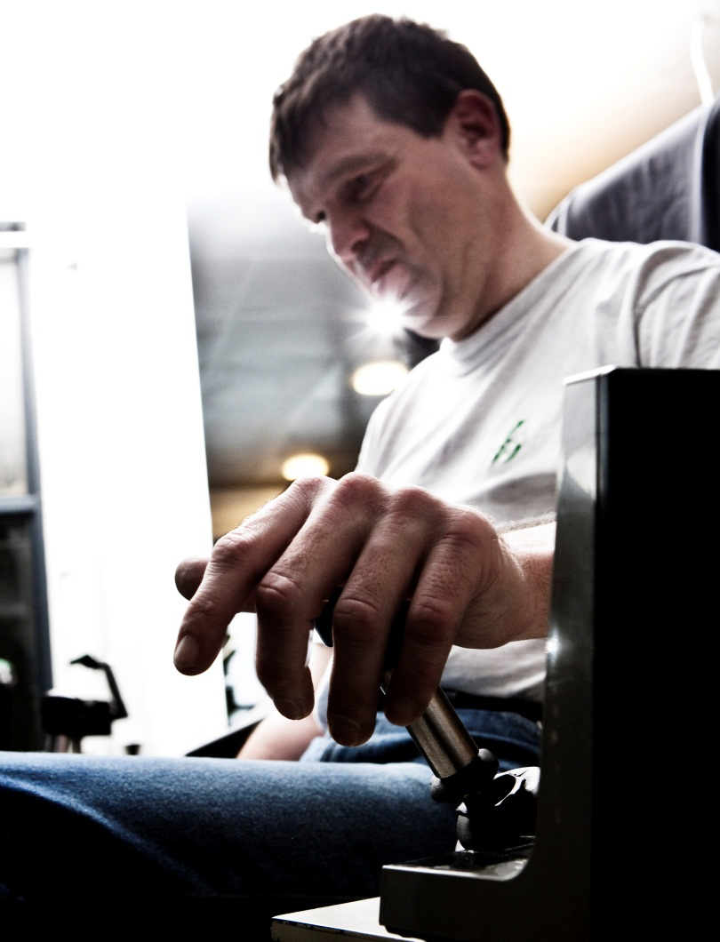
What may he learn that may change his life world?
The body may participate even if it does not fit into the cultural norm of the body, because it is part of a social community providing room for the body as it is.
He gets a counter-image to the conception that the body has to become ‘normalised’ to participaet and to be productive.

Slide 23
Beeing visible
Physically disabled people often feel ignored or invisible to other people.
When they show up doing physical activity they feel thet they become visible to others in a positive way. The focus is directed towards their special abilities.
Other people feel less uncomfortable by meeting the person because of his special competences.

Slide 24
Example: Narrative
But people also view me differently if I come along on my bike compared to my wheelchair. If people pull themselves together and come up and manage to ask: ‘Why are you in a wheelchair?’, then I can answer. But when I come on my bike, then it’s: ‘Wow, that’s a great bike! How fast can it go? How many gears has it got? I wish I had one like that’, and so on and so forth. So in that case it’s not mostly about the disability, it’s the bike they ask about first. So then they have a different view and experience of me when I come on my bike instead of in a wheelchair. It’s a very obvious difference. No matter where you go, there aren’t many people who start talking to you when you’re in a wheelchair. They turn the other way, or whatever.

Slide 25
Scenic description
For his run today, he has planned a route out into the countryside. The first section is on a cycle path along a route into town. When he is driving there, one may notice how low he lies in his handbike, almost like in a go-cart. He is an obvious feature of the townscape, noticed by all who meet him. Some wave to him. Soon he turns left and cycles out of town.

Slide 26
What does he learn that may change his life world?
You must be visible to develop participation.
Other persons get ‘courage’ to support his participation through help and appreciation.
It is possible to move into a new social context.

Slide 27
Social appreciation and respect
The informants experience, that other people react positively surprised and that they are attributed to higher status when they show themselves as physically active persons.
Creates a counter image to the stereotype perception that they are inactive and in-capable
Positive expectations from others and the person expecting himself that he is able to paticipate in vairous other contexts as well, seem facilitate social participation.

Slide 28
Example: Narrative
It happens to me all the time that I meet other non-disabled people who ask: ‘Are you in the Paralympics?’ Then I say: ‘Oh, come on now!’ But I then I tell them that I play wheelchair rugby and what it is. And if you have a computer to hand and can go to the Internet and show video clips from websites or from YouTube or wherever they are, they are very impressed and find it quite amazing after all, what people can do.

Slide 29
A lot of people think, ‘Well, he’s sitting at home reading the paper – he’s a pensioner’, or something or other. And when in fact I both have a job and do sport, well, it’s like your social status improves.

Slide 30
But you know, bottom line, it’s got something to do with the fact that you’re showing that you can do something. When you’re capable of something, you also get a slightly higher status in society in general.

Slide 31
What does he learn that may change his life world?
Demonstrating competecies in various contexts implies respect and positive expectations in the surroundings
Opens space for participation in various social contexts so that the person gets the opportunity to contribute with his abilities and further develop his competencies
As the person participates fully stigma is weakened and the persons power to act is enhanced

Slide 32
New perspectives for research in this
From focus on the individual to focus on social communities.
Social communities as spaces for development in rehabilitation:
How do we make social communities into places where people with different conditons and abilities may develop participation together?

Slide 33
Articles published based on the results
’Participation in physical activity and everyday life of people with physical disabilities: A review of the literature.’
Scandinavian Journal of Disability Research, online 2. sept. 2013.
’Participation in physical activities and everyday life of people with disabilities.’ European Journal of Adapted Physical Activity 2012. 5(2), 65-81.
‘Krop og funktionshæmning’. I: Bonfils, I. S., Kirkebæk, B., Olsen, L. & Tetler, S. 2013. Handicapforståelser-mellem teori, erfaring og virkelighed. Copenhagen: Akademisk Forlag
(Octobre 2013)

Slide 34
Thank you
Anne-Merete Kissow
ak@handivid.dk
Danish Disability Sport Information Centre
www.handivid.dk

